Slide 1
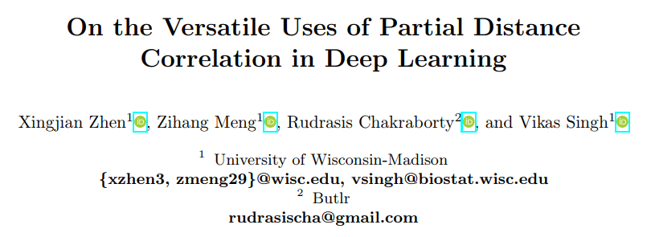
ECCV 2022

Slide 2
Motivation
systematic comparison of function, especially across different networks, remains difficult and is often carried out layer by layer.
Contribution
PDC can evaluate correlation between feature spaces of different dimensions, and complex nonlinear relationships.
Helps learn mutually independent features, have better robustness against adversarial attacks.
Measure Similarity between Neural Networks,
Make the factors in the latent variables independent

Slide 3
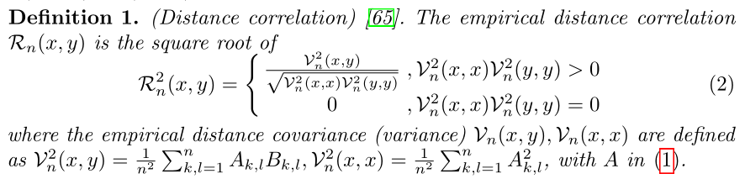
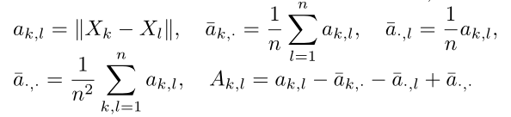
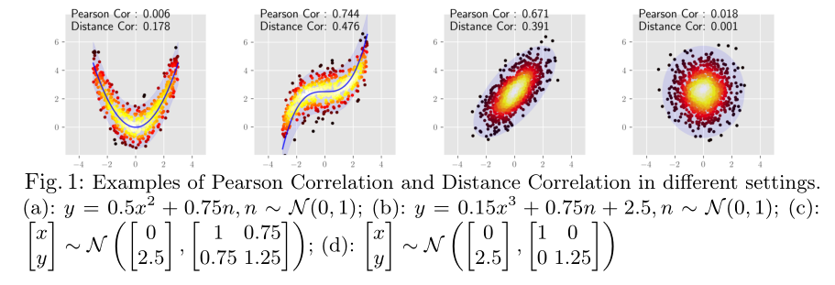
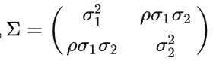
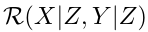
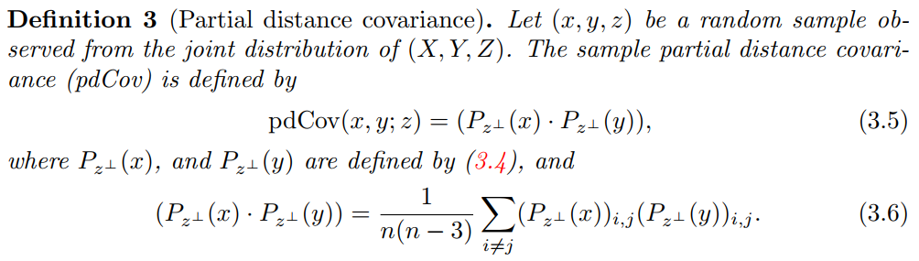
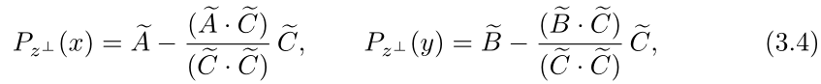
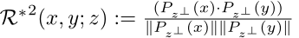

Slide 4
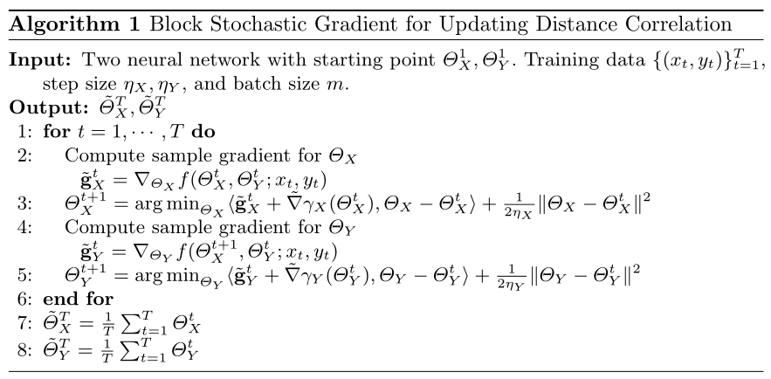
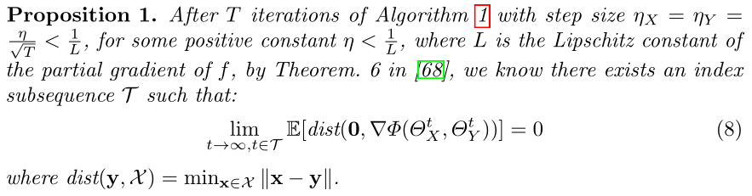
Optimizing Distance Correlation in Neural Networks

Slide 5
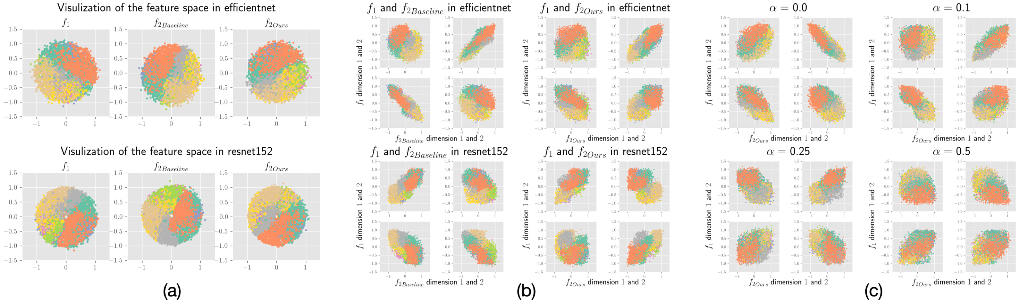
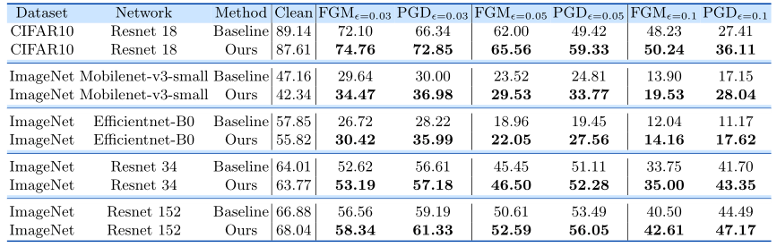
Experiments
Independent Features Help Robustness
same architecture, trained on the same data
f1
f2

Slide 6
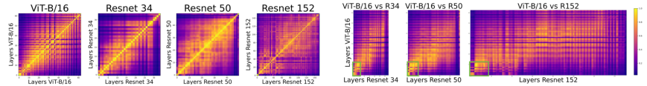
Experiments
Informative Comparisons between Networks
similarities between different layers of ViT and ResNets using distance correlation
distance correlation is a reasonable alternative for CKA
(a)
(b)

Slide 7
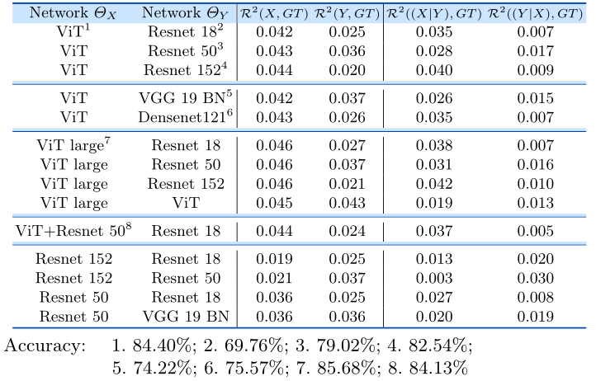
Experiments
Informative Comparisons between Networks
similarity between the features of the network X and the ground truth labels
extends it to multiple networks by partial distance correlation

Slide 8
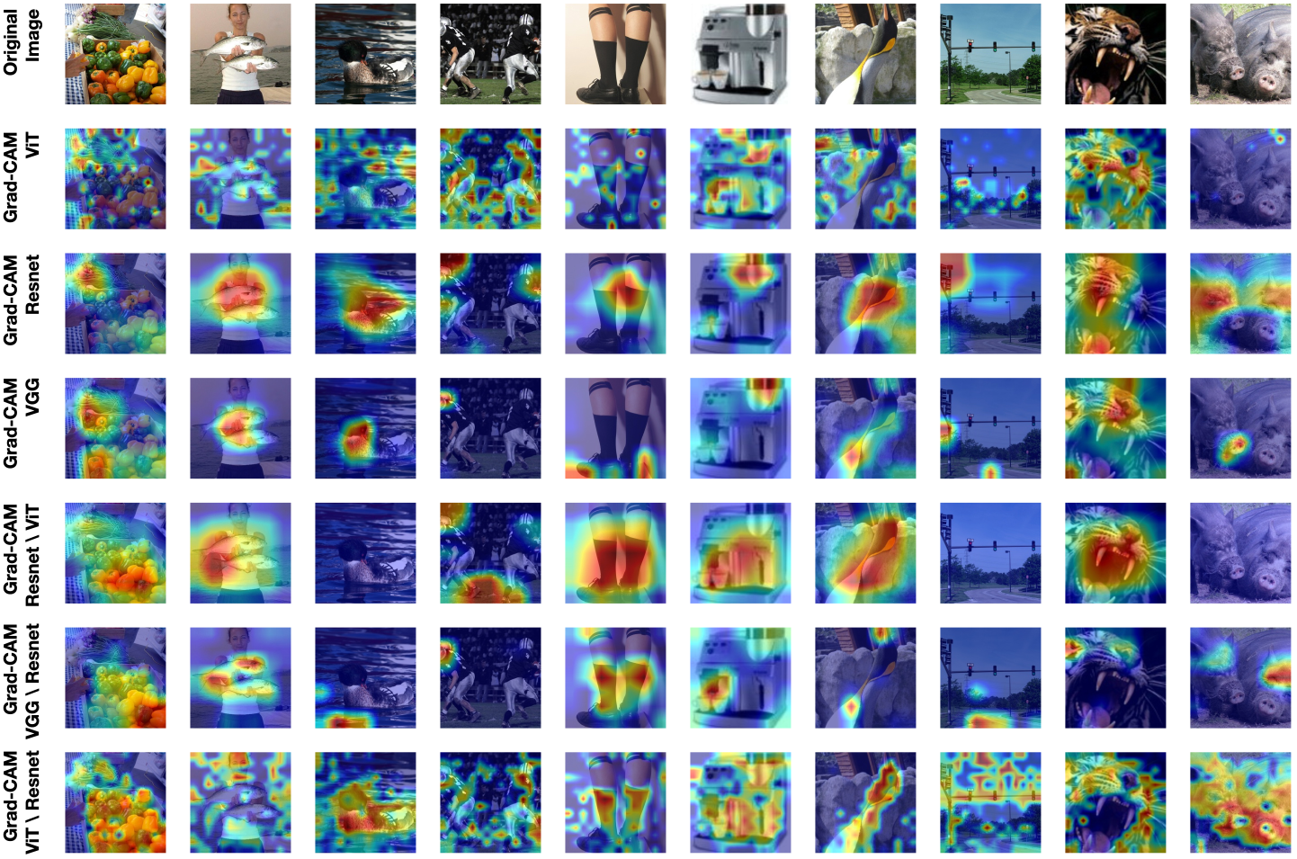
Experiments
Informative Comparisons between Networks
asking the network ΘX to learn concepts above and beyond what the network ΘY has learned.
max

Slide 9
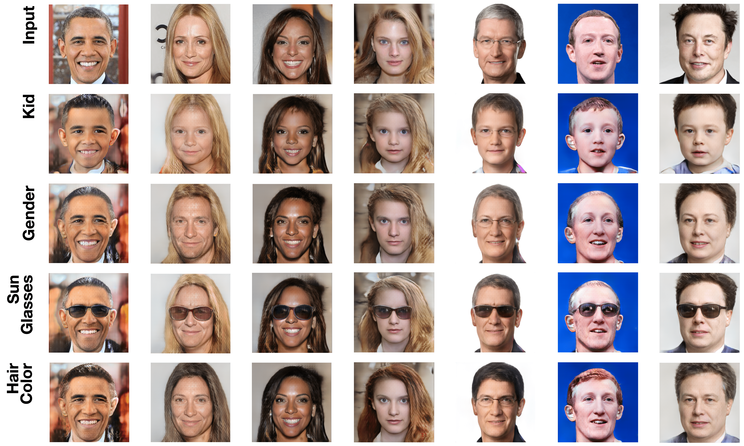
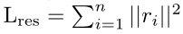
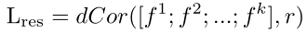
Experiments
Disentanglement
make the factors in the latent variables independent

